Slide 1

Swift Minters

Slide 2
Agenda
Introduction
Building confidence
Engaging the audience
Visual aids
Final tips & takeaways

Slide 3

The power of innovative Tech

Slide 4

Crypto Market
A innovative place to exchange

Slide 5
What are Nfts
Before Bitcoin was an ETF , in 2014 it was the first to have a image, The technology used was a Smart contract and in 2017 the Ethereum blockchain had its own take for those contracts
Those technologies are Ethereum Request for Comment known as ERC standards, created in the decentralized web environments for peer-to peer tokens to have a standard.
Updated and approved in Openzepplin community Standards for contract creation are examined for it's decentralized intended use ERC-20
NFT created in ERC-20 are non-fungible or fungible assets that hold value in the Tokenconomy for creation of a sub-economy that shows it's true usefulness by way of Real estate sales, Artwork,

Slide 6
Selecting visual aids
Enhancing your presentation

Slide 7
Effective delivery techniques
This is a powerful tool in public speaking. It involves varying pitch, tone, and volume to convey emotion, emphasize points, and maintain interest:
Pitch variation
Tone inflection
Volume control
Effective body language enhances your message, making it more impactful and memorable:
Meaningful eye contact
Purposeful gestures
Maintain good posture
Control your expressions

Slide 8
Effective delivery techniques
This is a powerful tool in public speaking. It involves varying pitch, tone, and volume to convey emotion, emphasize points, and maintain interest:
Pitch variation
Tone inflection
Volume control
Effective body language enhances your message, making it more impactful and memorable:
Meaningful eye contact
Purposeful gestures
Maintain good posture
Control your expressions

Slide 9
Navigating Q&A sessions
Know your material in advance
Anticipate common questions
Rehearse your responses
Maintaining composure during the Q&A session is essential for projecting confidence and authority. Consider the following tips for staying composed:
Stay calm
Actively listen
Pause and reflect
Maintain eye contact

Slide 10
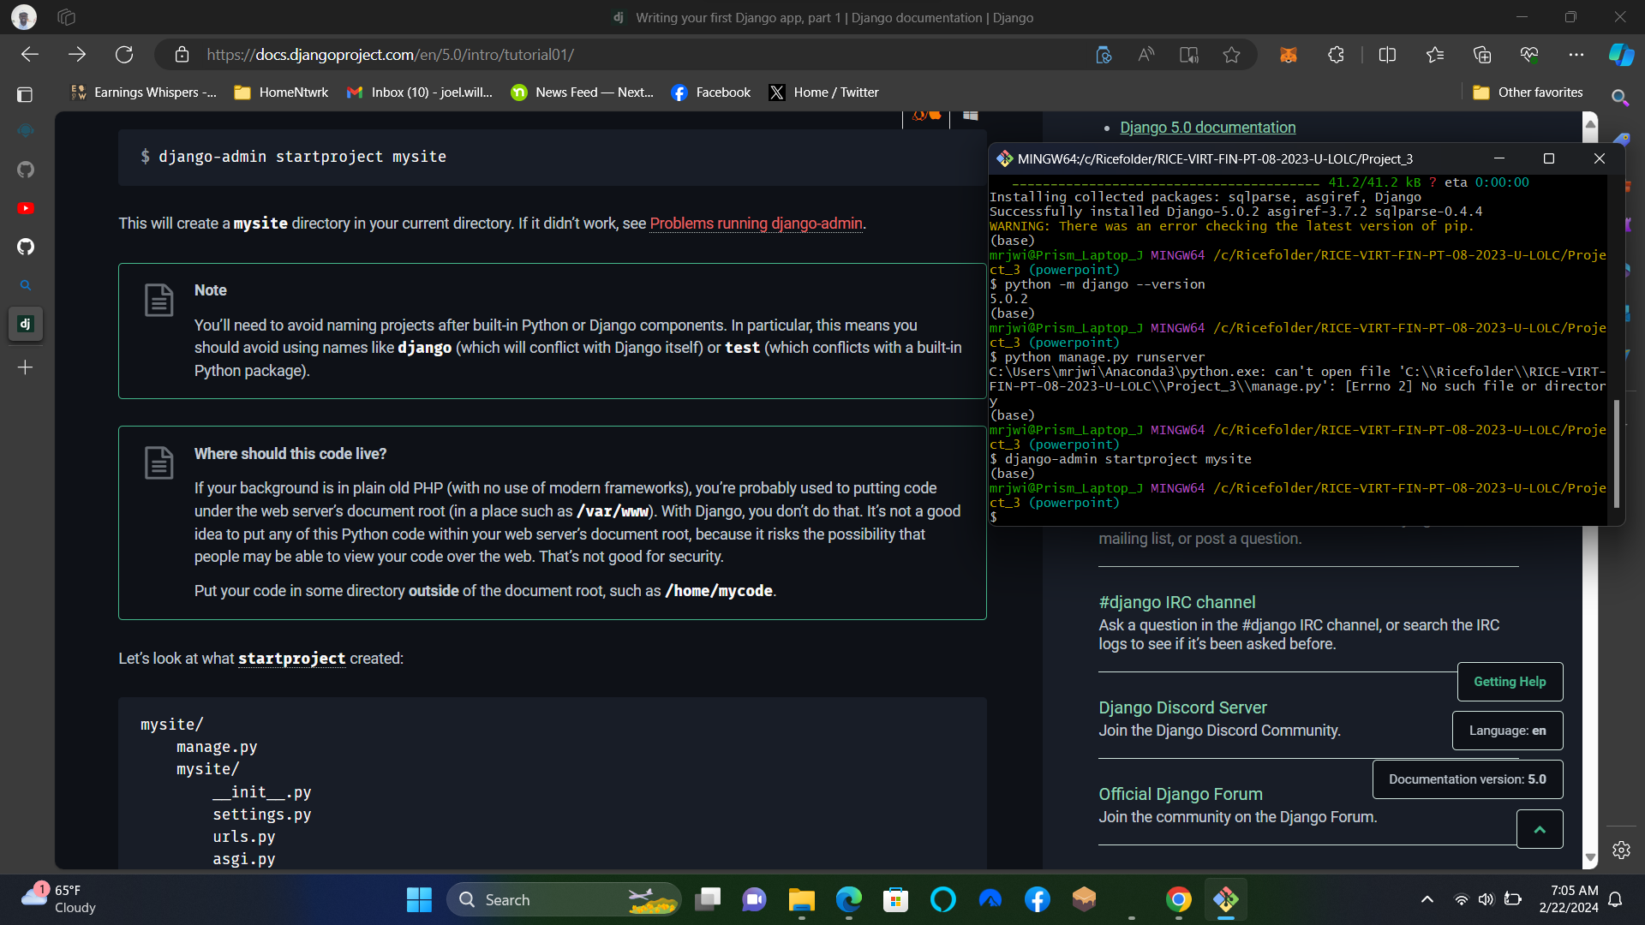
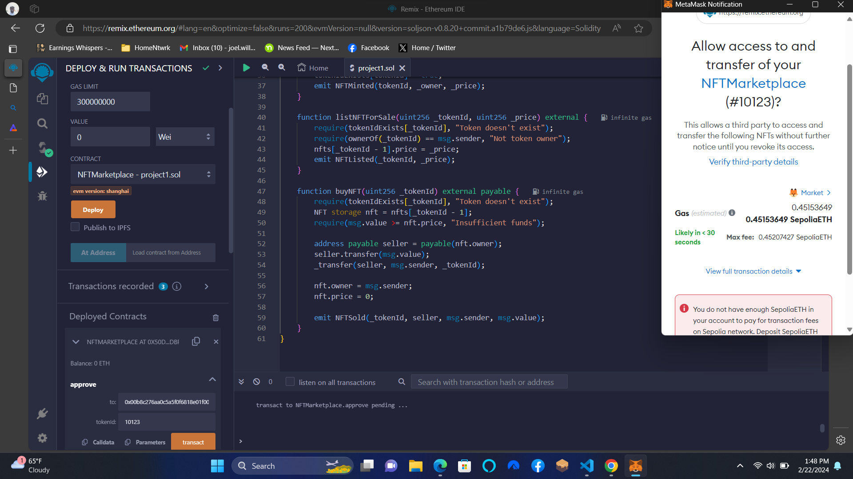
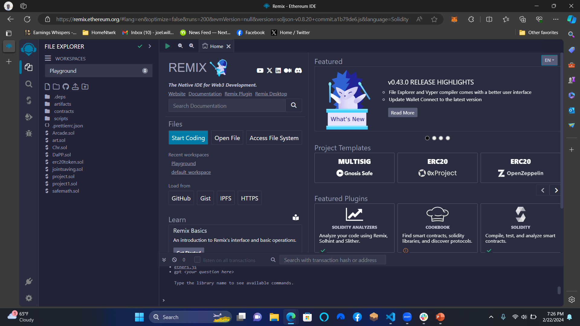

Slide 11
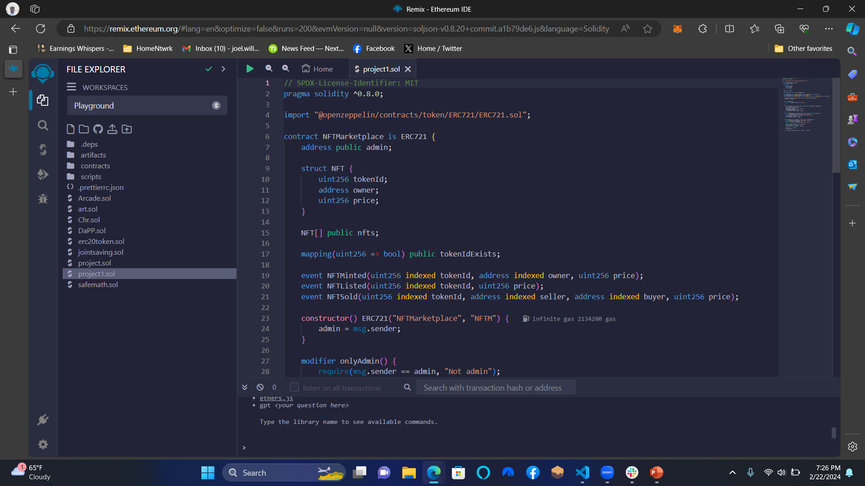

Slide 12
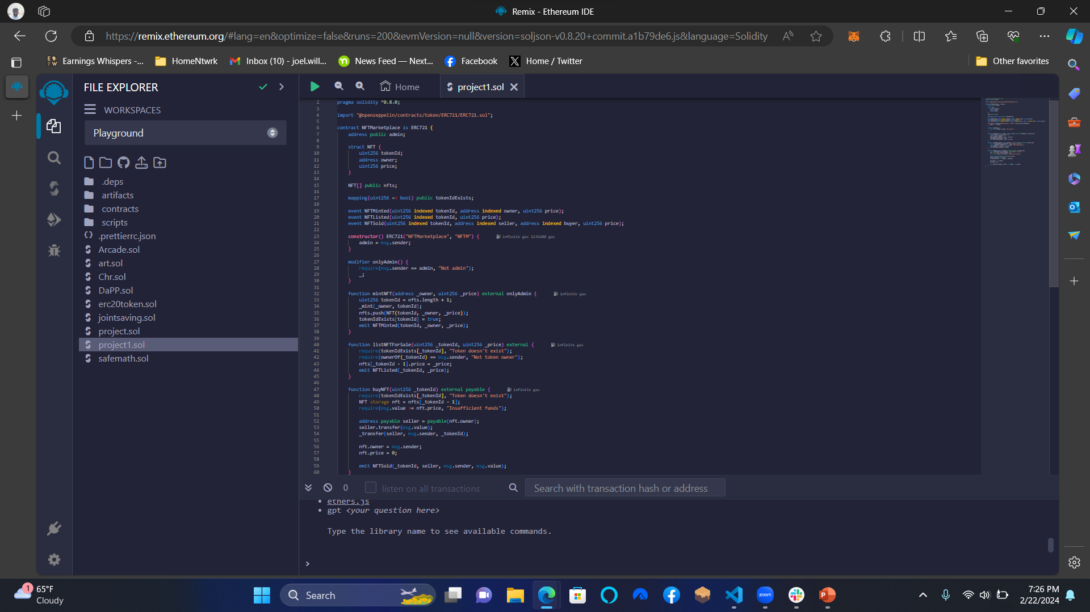

Slide 13
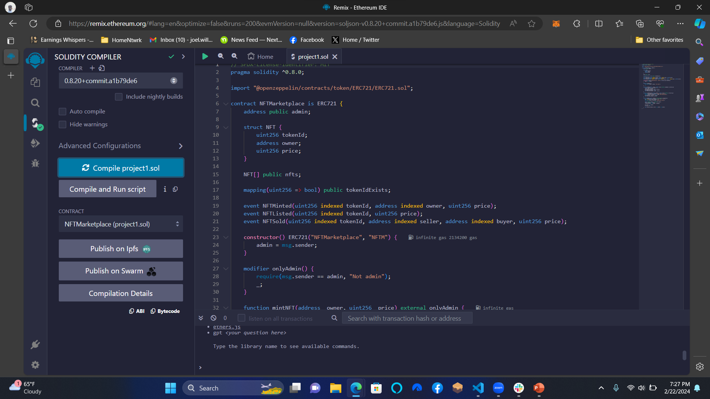

Slide 14


Slide 15
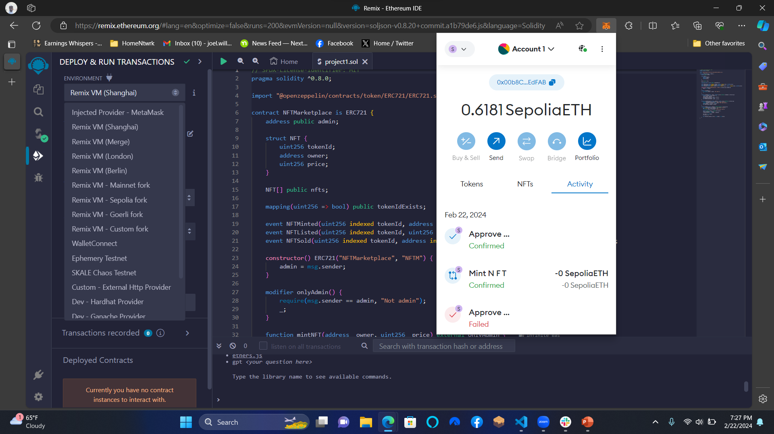

Slide 16
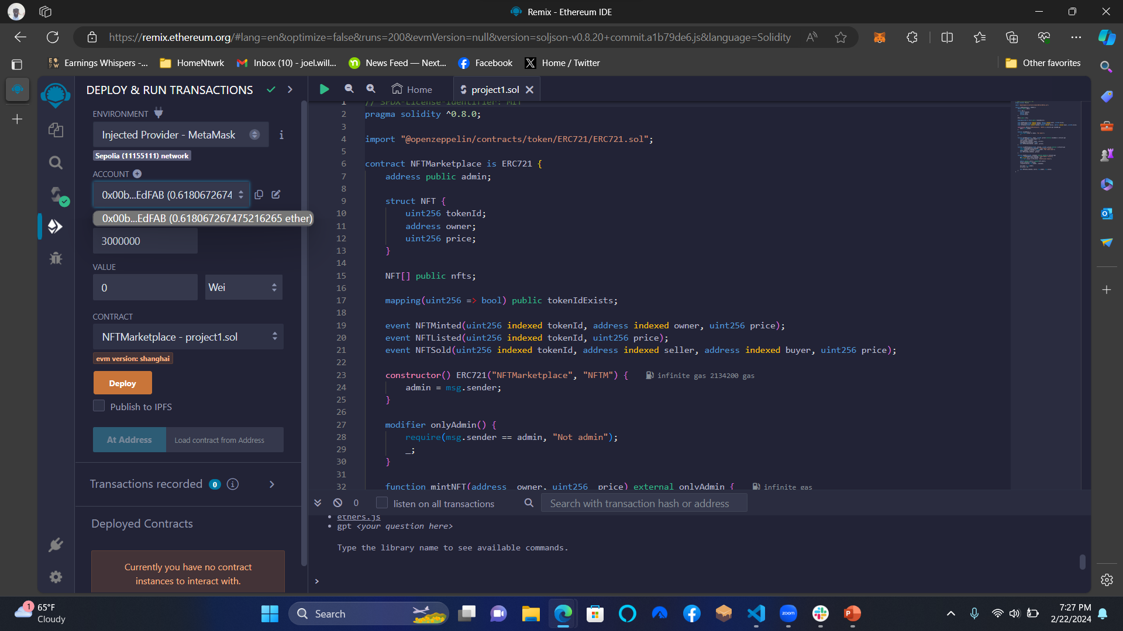

Slide 17
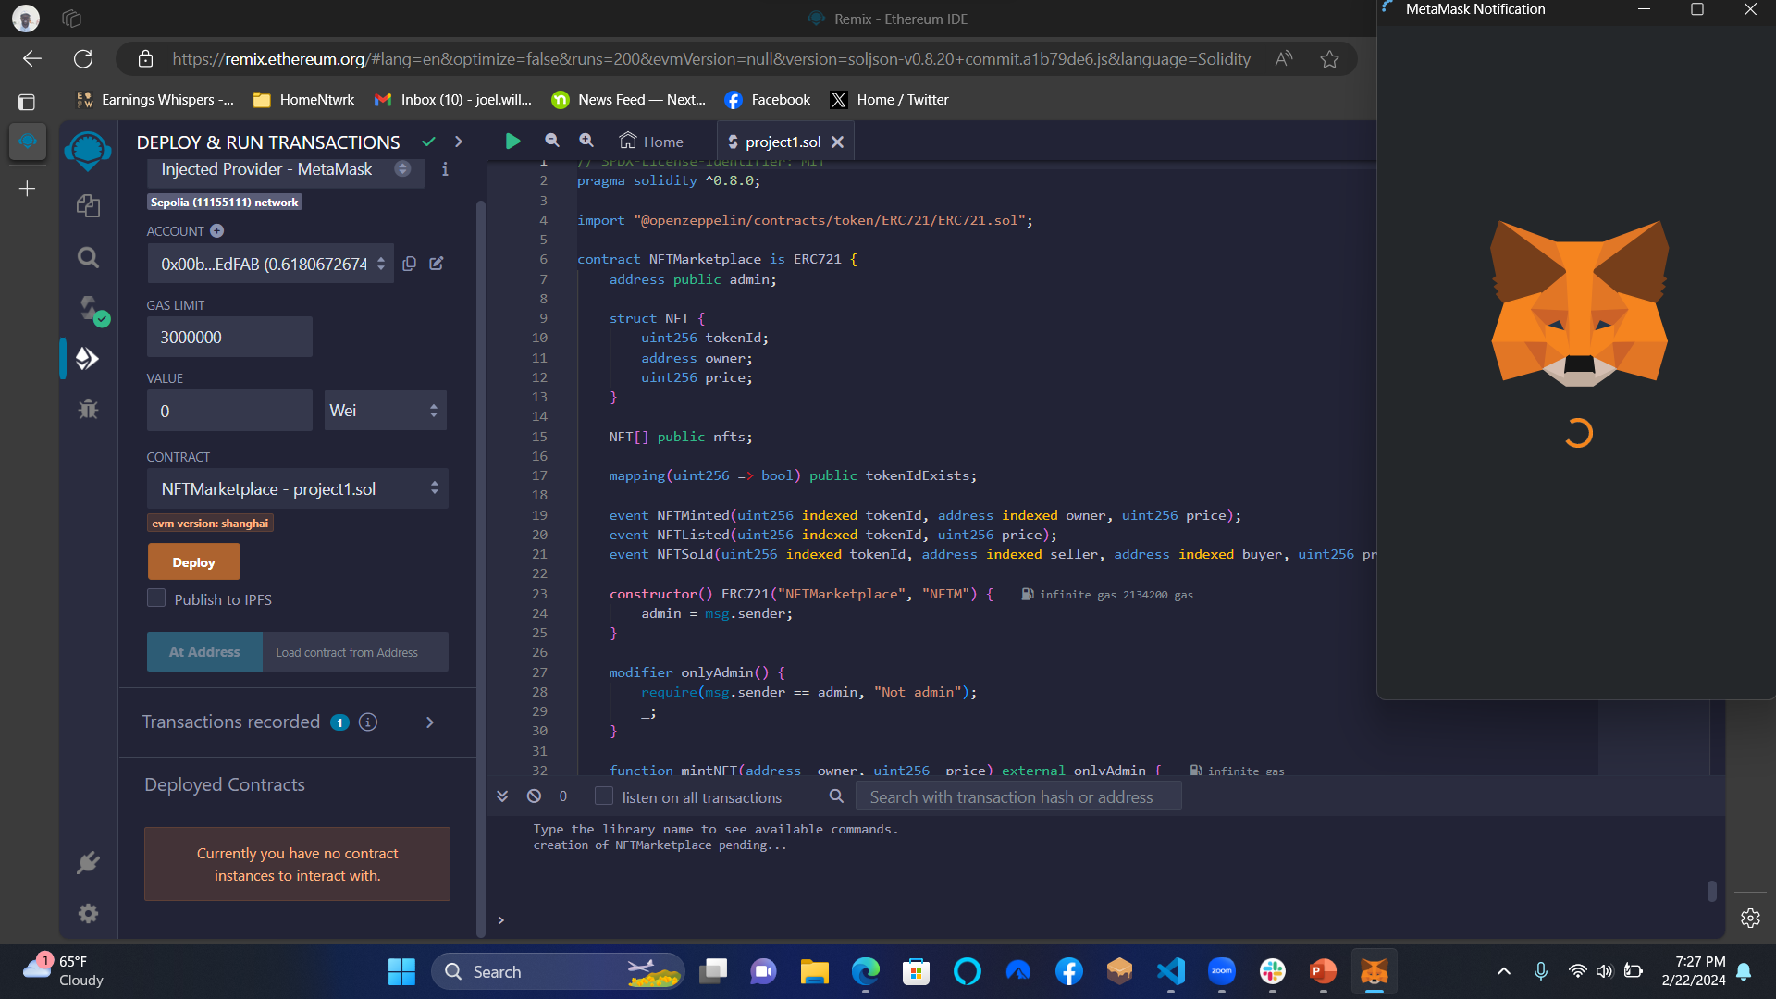

Slide 18
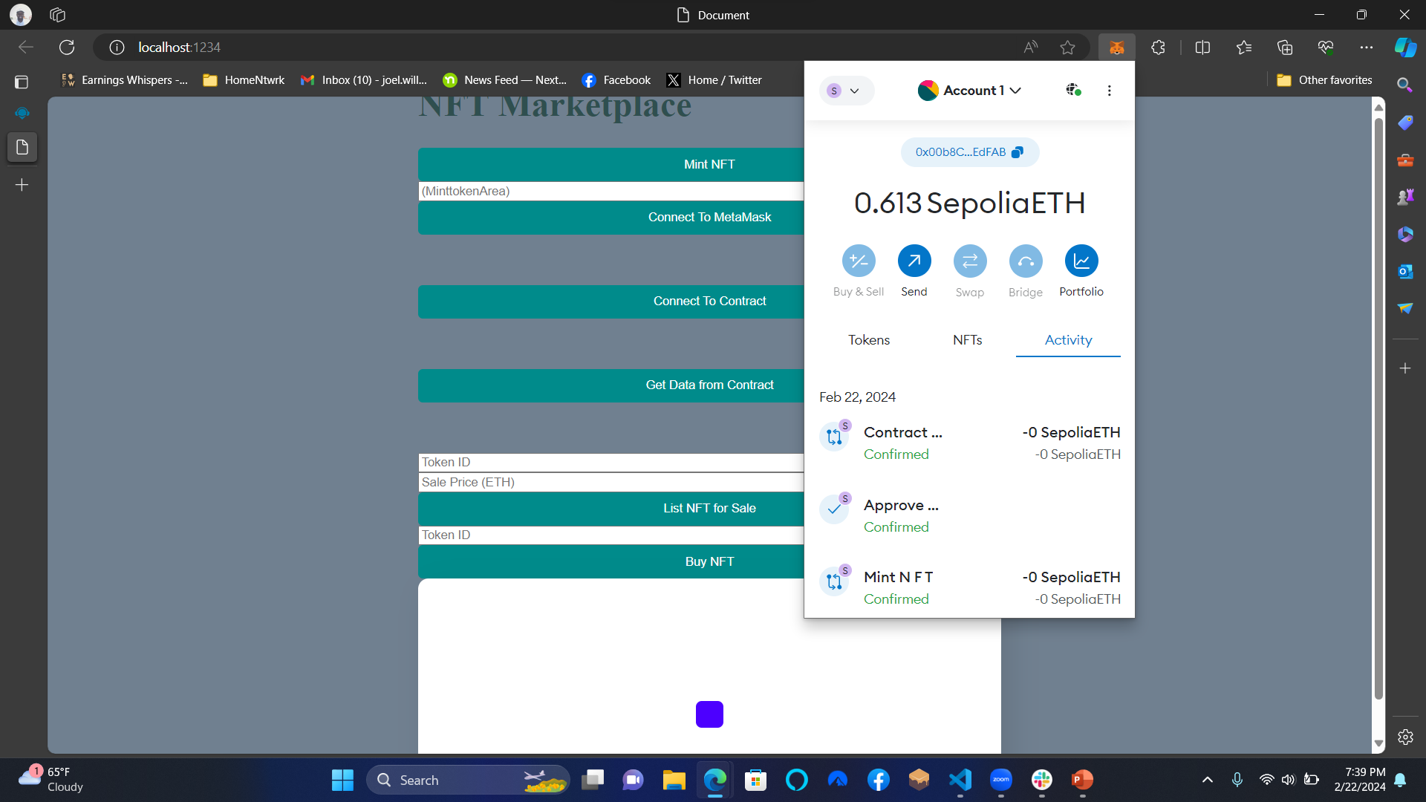

Slide 19
Dynamic delivery
Learn to infuse energy into your delivery to leave a lasting impression
One of the goals of effective communication is to motivate your audience
Metric | Measurement | Target | Actual
Audience attendance | # of attendees | 150 | 120
Engagement duration | Minutes | 60 | 75
Q&A interaction | # of questions | 10 | 15
Positive feedback | Percentage (%) | 90 | 95
Rate of information retention | Percentage (%) | 80 | 85

Slide 20
Final tips & takeaways
Consistent rehearsal
Strengthen your familiarity
Refine delivery style
Pacing, tone, and emphasis
Timing and transitions
Aim for seamless, professional delivery
Practice audience
Enlist colleagues to listen & provide feedback
Seek feedback
Reflect on performance
Explore new techniques
Set personal goals
Iterate and adapt

Slide 21
Navigating Q&A sessions
Impact factor | Measurement | Target | Achieved
Audience interaction | Percentage (%) | 85 | 88
Knowledge retention | Percentage (%) | 75 | 80
Post-presentation surveys | Average rating | 4.2 | 4.5
Referral rate | Percentage (%) | 10 | 12
Collaboration opportunities | # of opportunities | 8 | 10

Slide 22
Thank you
Brita Tamm
502-555-0152
brita@firstupconsultants.com
www.firstupconsultants.com

